Slide 1
Automated Patch Extraction via Syntax- and Semantics-Aware Delta Debugging on Source Code Changes
Masatomo Hashimoto Akira Mori Tomonori Izumida
Chiba Institute of Technology
National Institute of
Advanced Industrial
Science and Technology
IIJ Innovation Institute

Slide 2
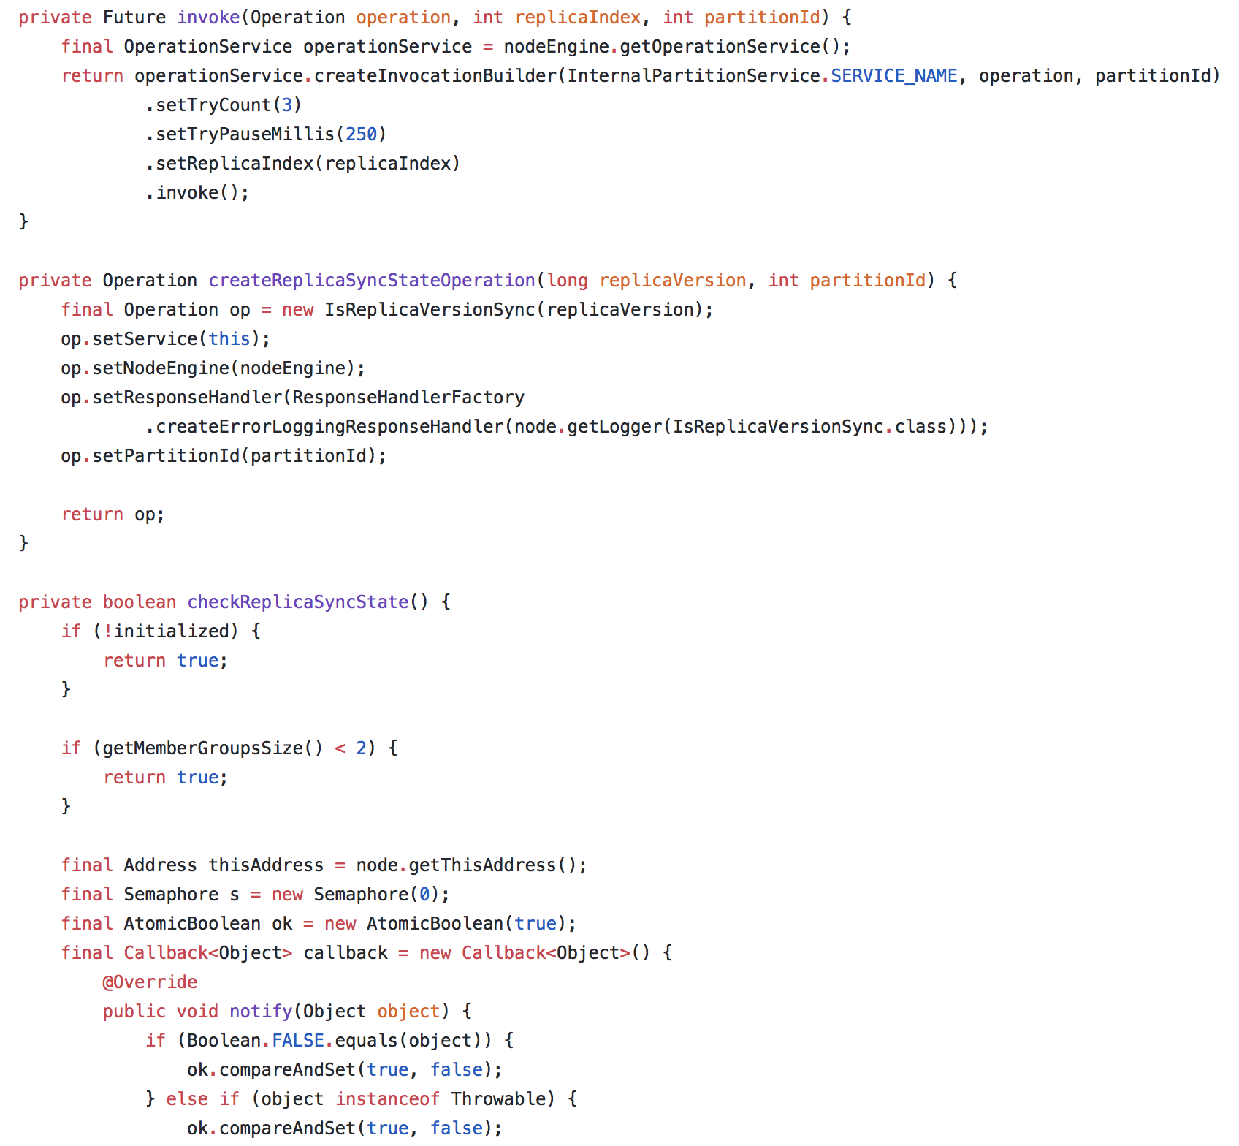
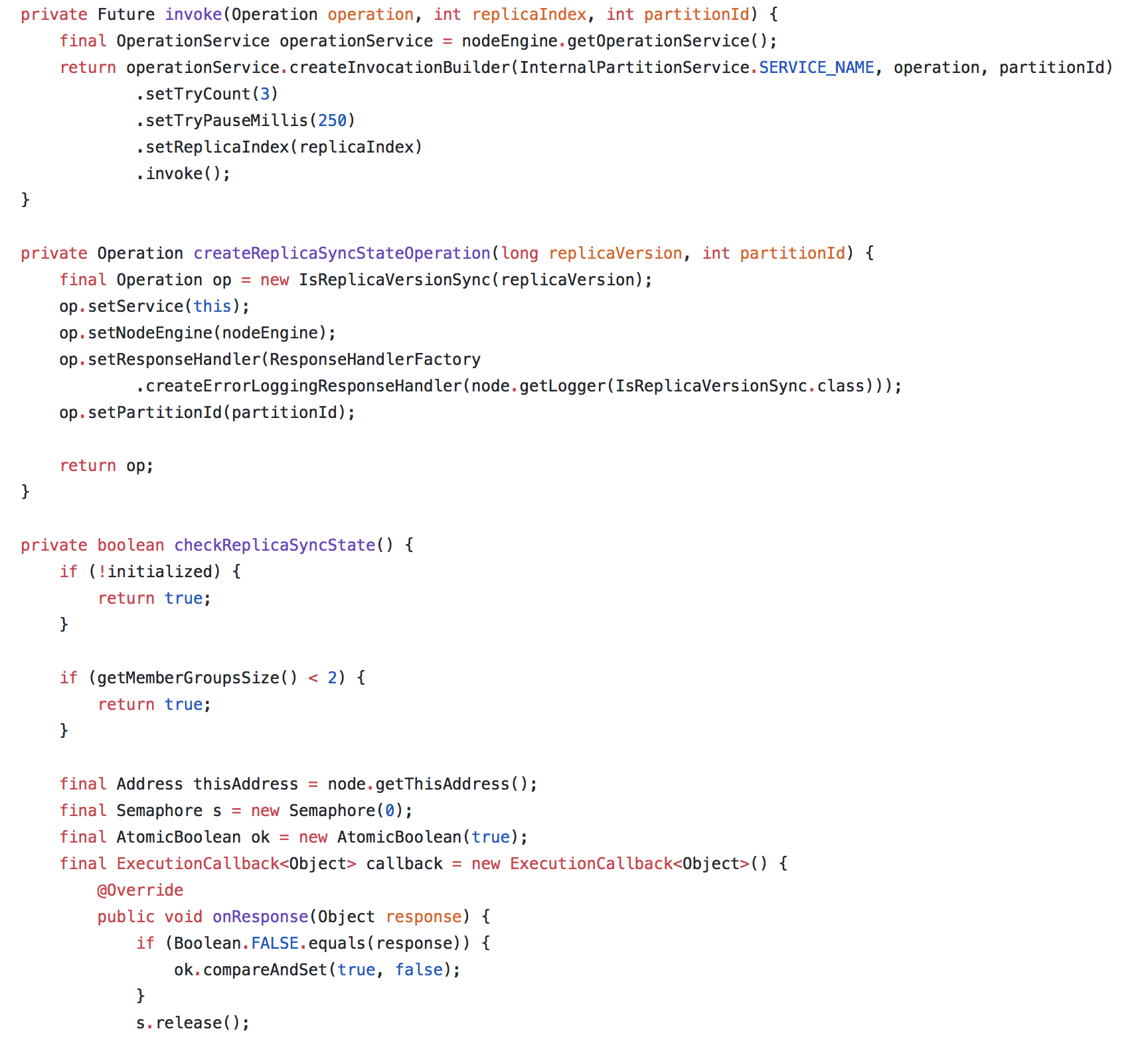
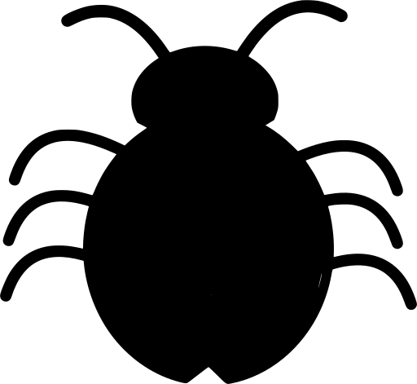
Software Regression
Changes (Delta)
✔︎
---
+++
---
+++
---
+++
---
+++
✘︎
PASSED
FAILED
Working version
Vgood
Test
Faulty version
Vbad

Slide 3
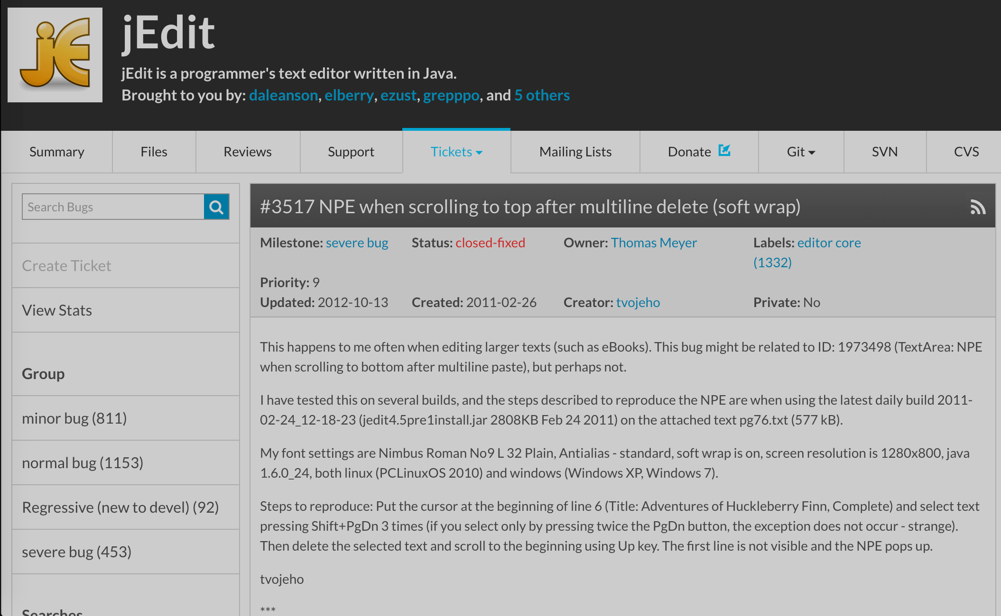
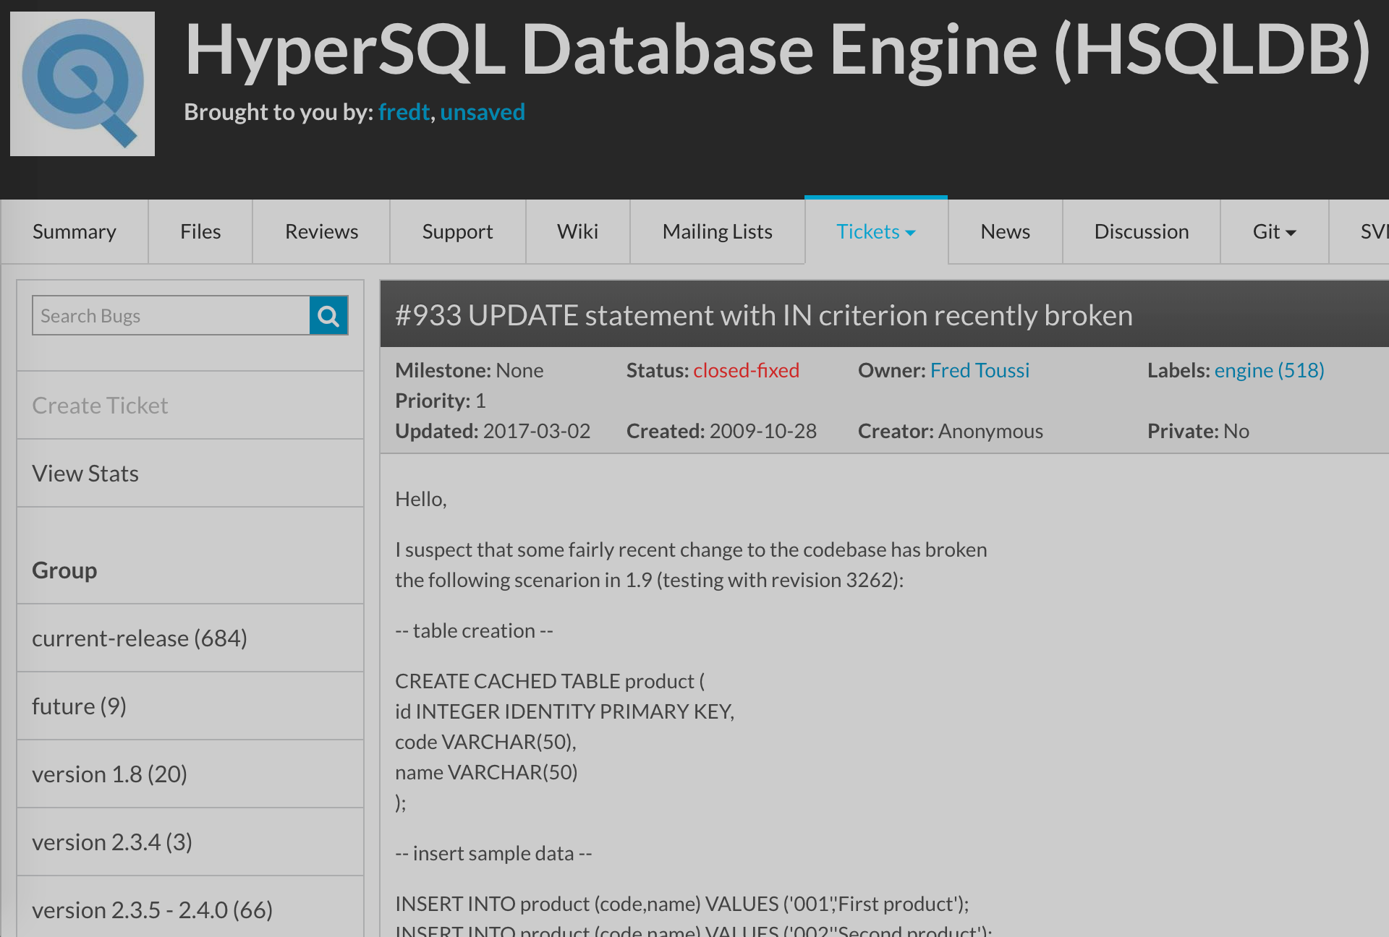
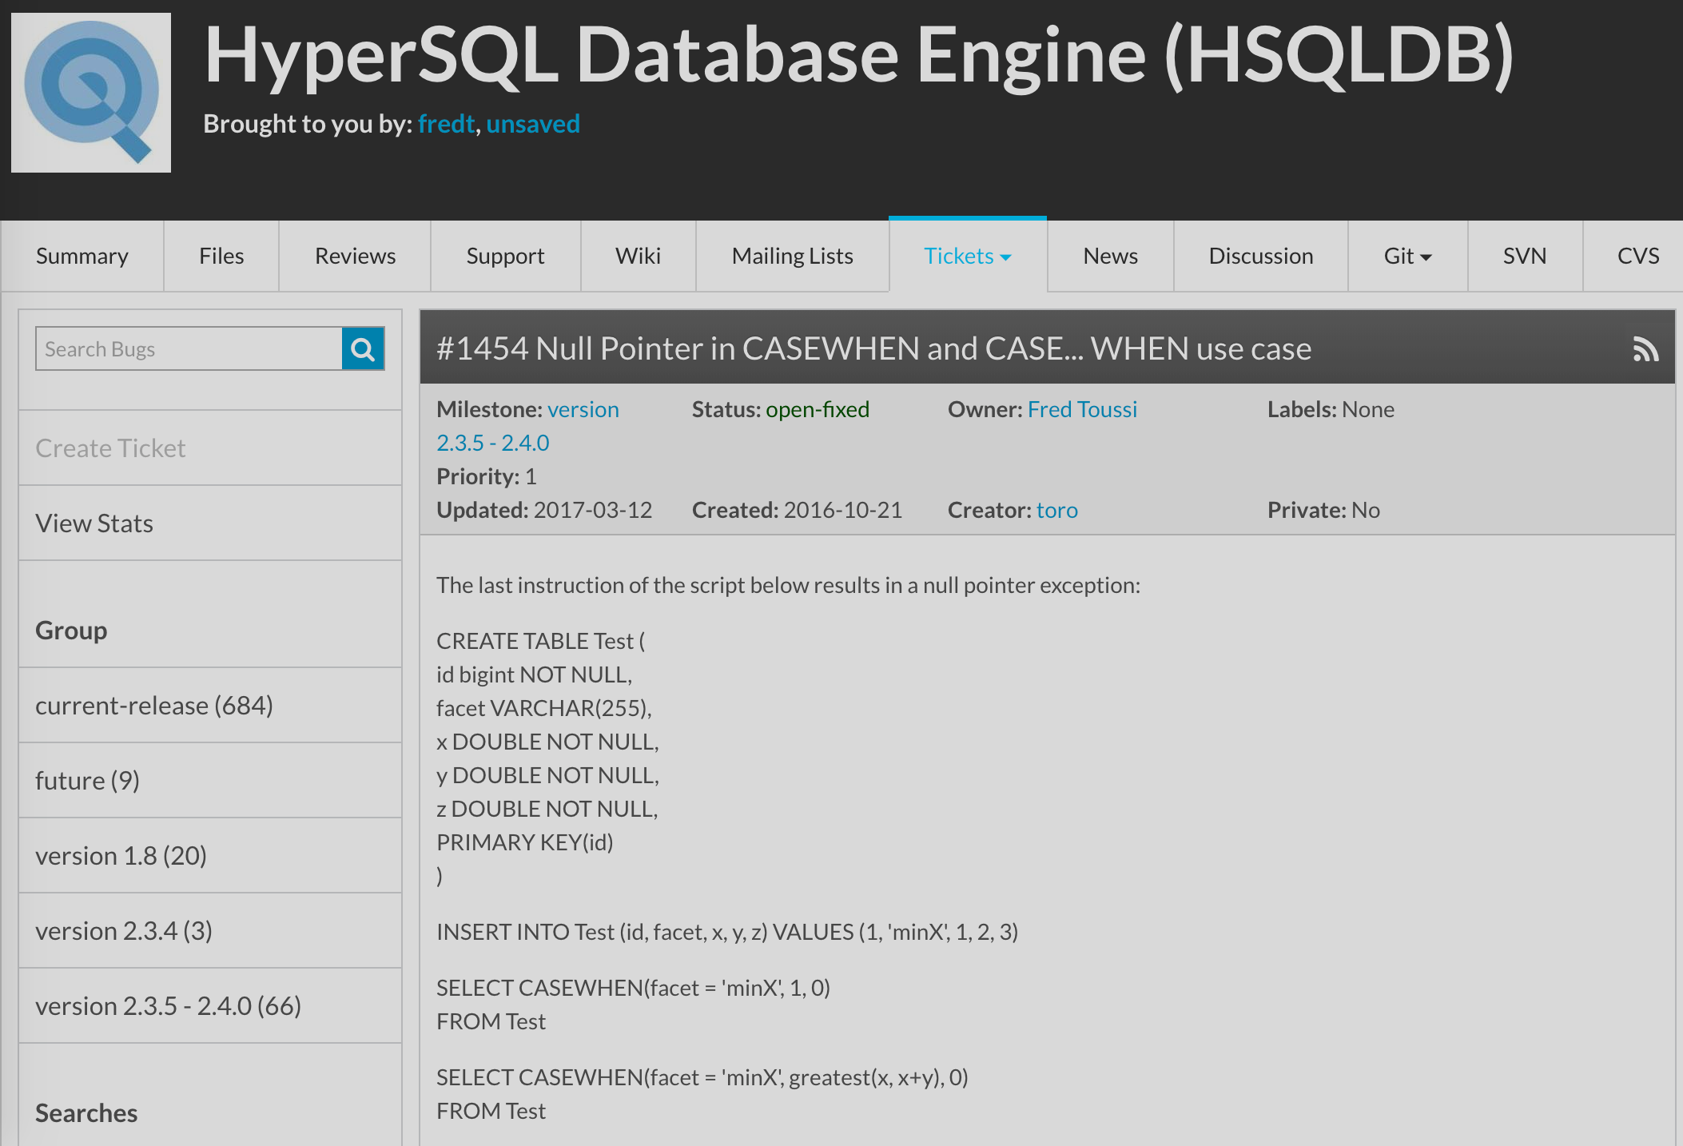
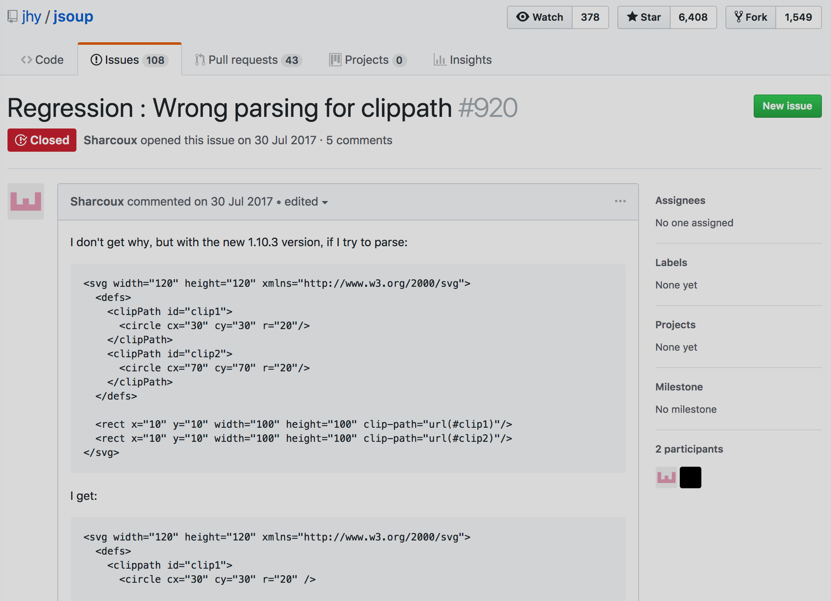
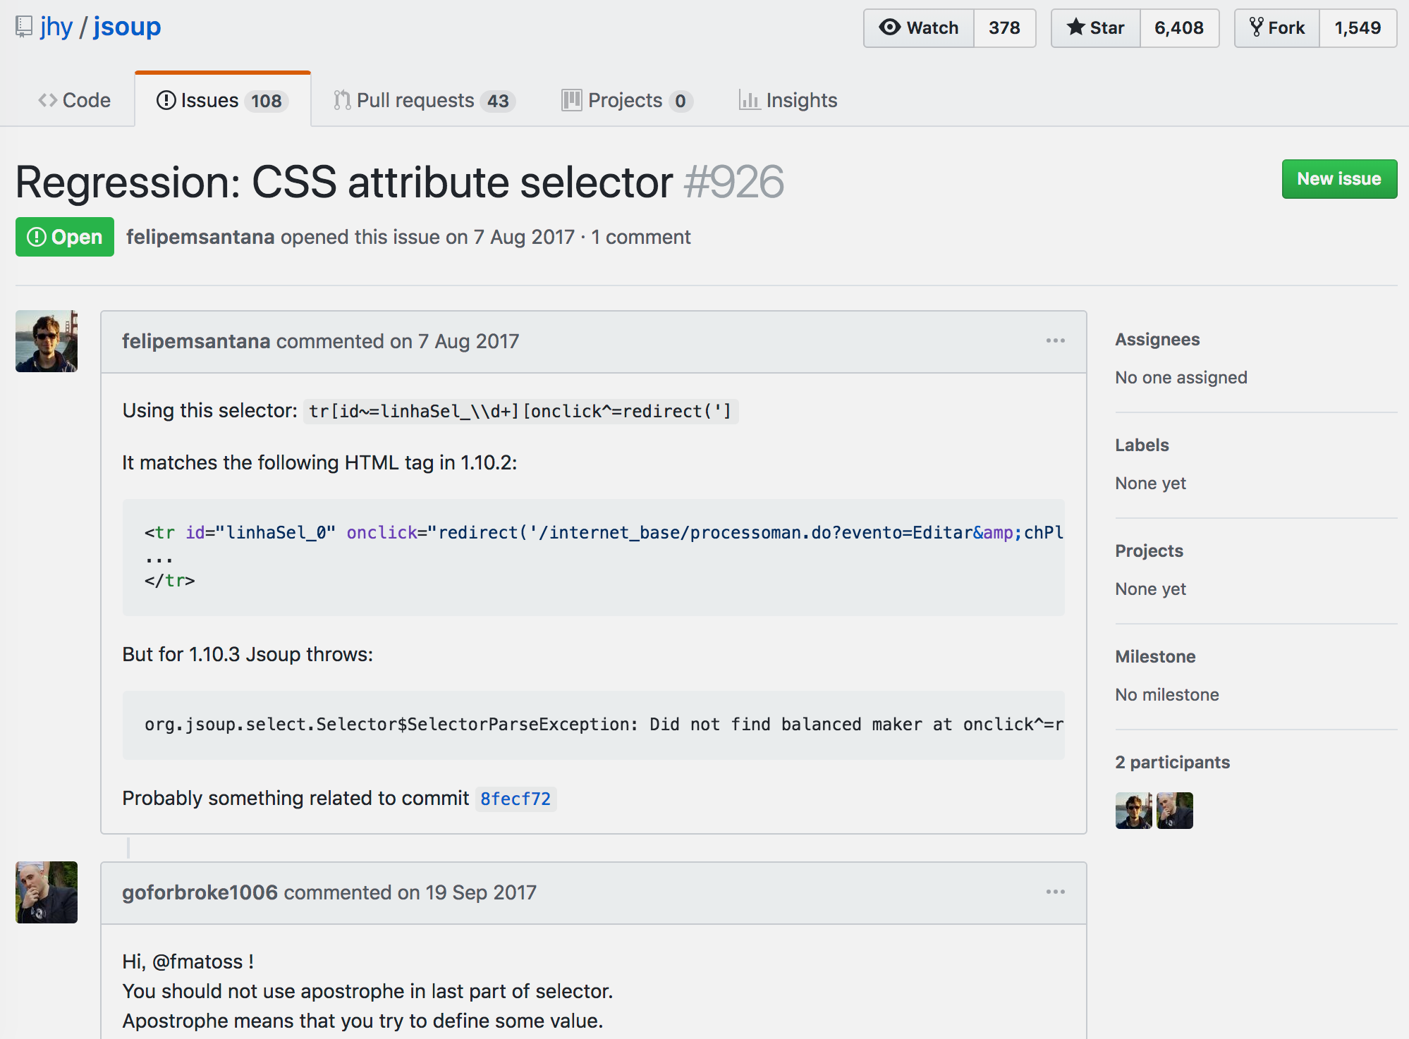
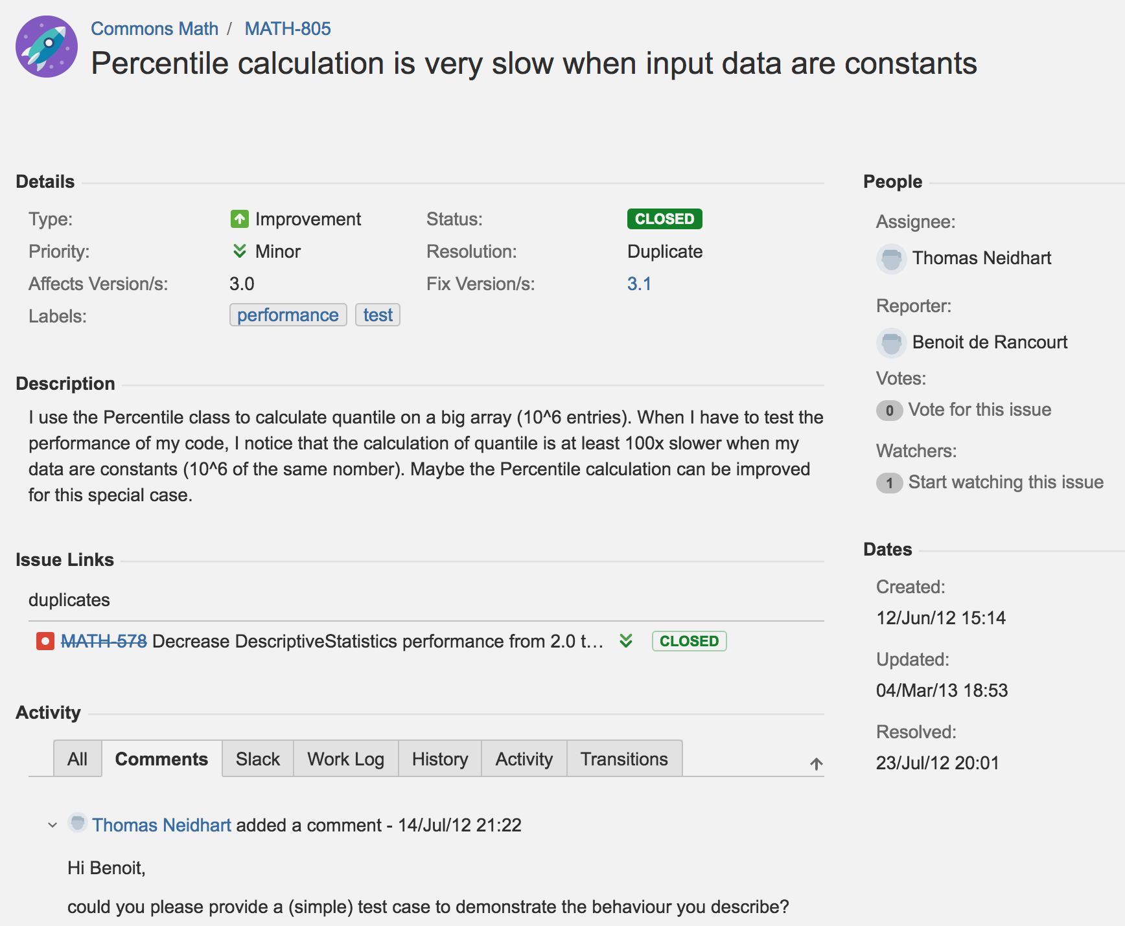
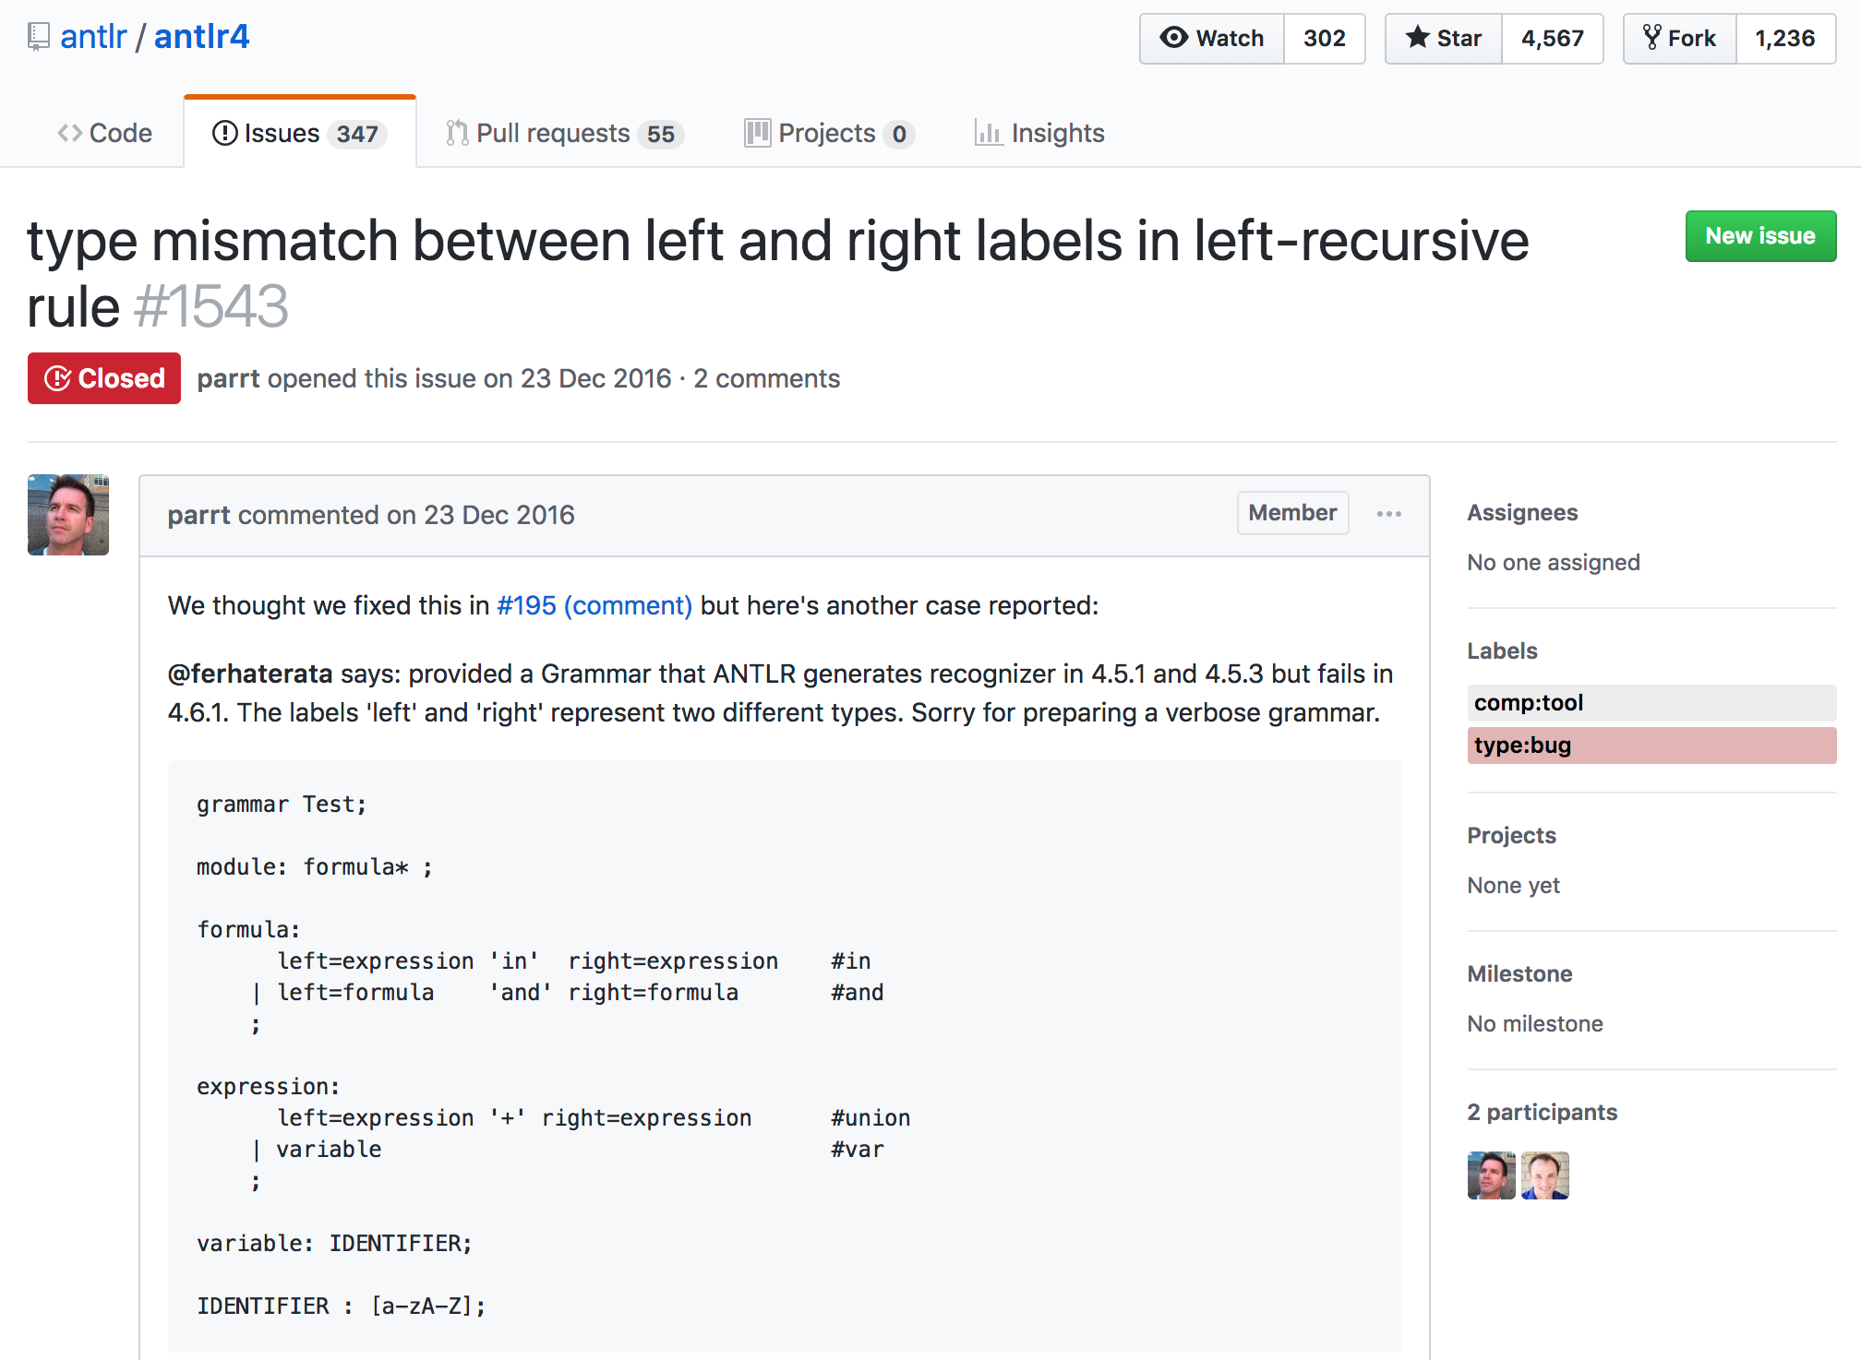
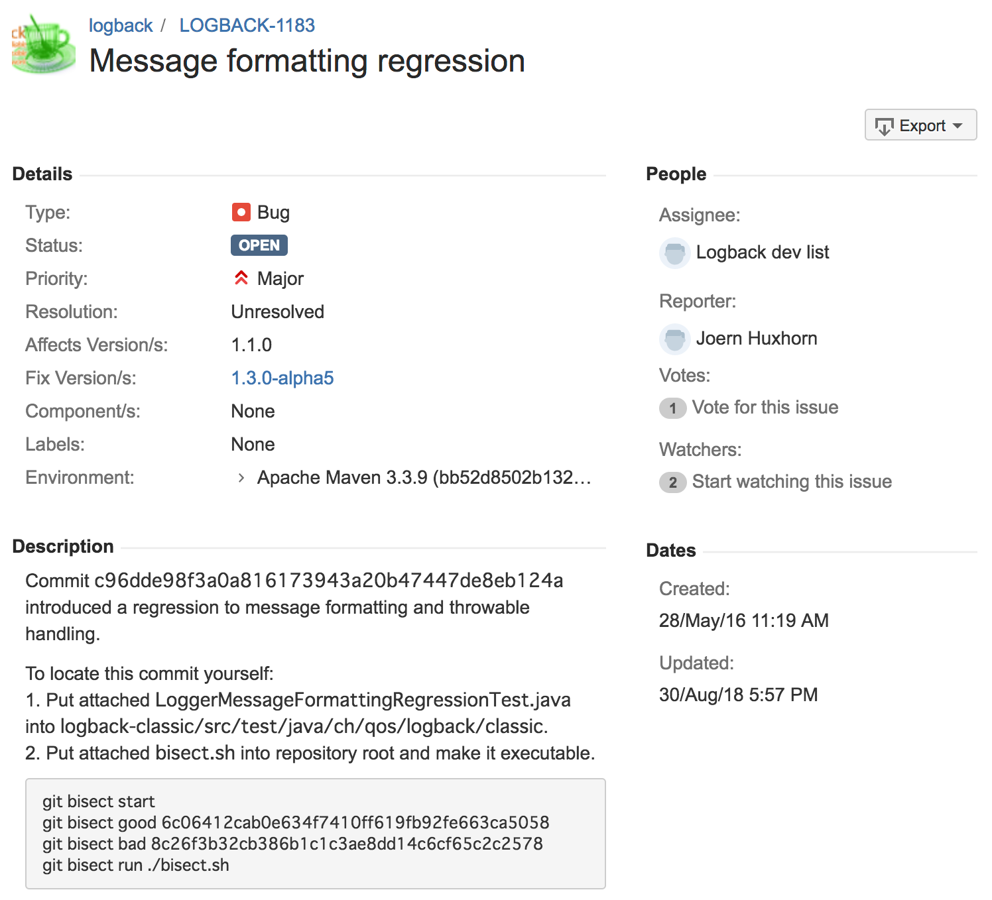
Real Regression Bugs

Slide 4
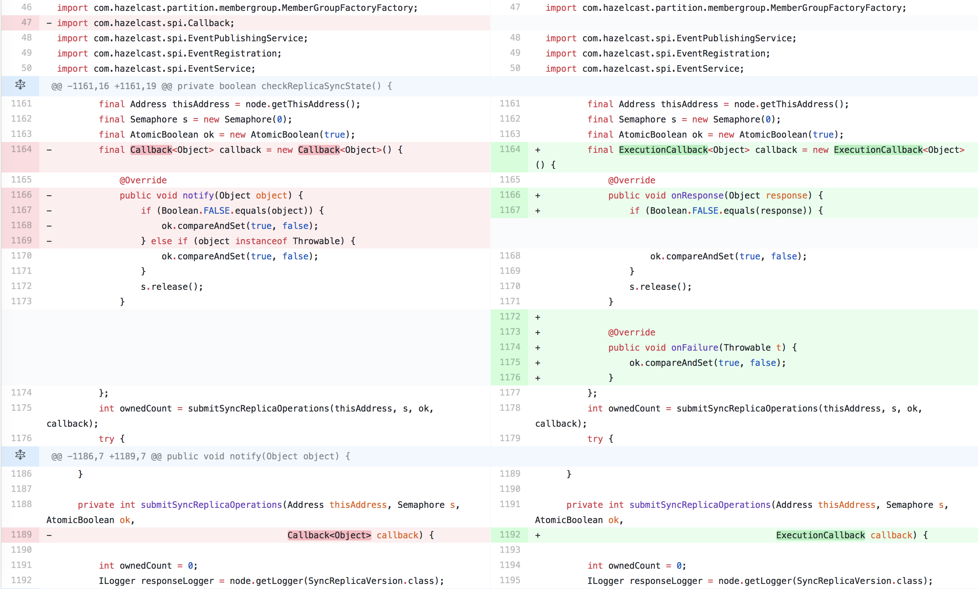
Delta Debugging on Source Code Changes
Yesterday, my program worked. Today it does not. Why? [Zeller, 1999]
Compare source code
Decompose delta
Bisect, select, patch
Build and test
---
+++
---
+++
---
+++
---
+++
---
+++
---
+++
---
+++
---
+++
---
+++
---
+++
✘︎
✔︎
Vgood
Vbad
---
+++
---
+++
1
2
3
4

Slide 5
Is DD Practical for Real Regressions?
Complexity of DD [Zeller-Hildebrandt, 2002]
Test executions w.r.t. number of hunks (delta components)
Logarithmic (best case) to quadratic (worst case)
Factors that increase complexity [Zeller, 1999]
Inconsistency: test may result in UNRESOLVED
...
Example:
Delta decomposed into 952 hunks
826 test executions (8+ hours on AWS (16 cores, 8GB-RAM/core))
722 build failures (build success rate: 0.127)

Slide 6
Complexity Factors of DD [Zeller, 1999]
Inconsistency: UNRESOLVED test results exist
Interference: combination of multiple components induces failure
Non-monotony: non-failure inducing changes contain failure inducing changes
Ambiguity: disjoint sub-deltas induce failure

Slide 7
Causes of Build Failures
@@ ... @@
void m()
+ throws Abort
{
@@ ... @@
- try {
+ synchronized(a){
Syntax errors
"cannot find symbol" errors
"unreported exception" errors
...
@@ ... @@
- void m() { ... }
@@ ... @@
} finally {
w.unlock();
}
@@ ... @@
+ e = new Abort();
+ throw e;
@@ ... @@
- m();

Slide 8
Syntax- and Semantics-Aware Decomposition to Avoid Build Failures
Fine-grained delta decomposition into atomic changes
Abstract syntax tree (AST) instead of plain text
Deletion, insertion, relabeling, move of AST nodes
Rule-based coupling of atomic changes
By syntactic constraints
By refactoring patterns
By other change patterns
---
+++
---
+++
---
+++
---
+++
---
+++
---
+++
---
+++
---
+++

Slide 9
Comparing Abstract Syntax Trees (ASTs)
Original
Modified
f(a)
!
if(x||f(a))
return
break
if(!(x&&a))
break
return
||
&&
return
if
if
return
inserted
||
return
break
!
break
return
moved
relabeled
x
f
&&
@@ -1,3 +1,4 @@
-if (x||f(a))
- return
+if (!(x&&a))
break
+ return
deleted
Condition changed
Call removed
Negation inserted
Then-else interchanged
a
x
a

Slide 10
Tree Hunks
Delete hunk
Move hunk
Insert hunk

Slide 11
Rules for Coupling Tree Hunks
try
synchronized
Syntactic rules
E.g. try changed to synchronized
⬌ finally deleted
Refactoring-based rules
E.g. parameter removed (Remove Parameter)
⬌ argument removed
Change-based rules
E.g. uncaught throw added
⬌ throws added
finally
o.meth()
o.meth()
args
args
meth
meth
params
a
throws
x
throw

Slide 12
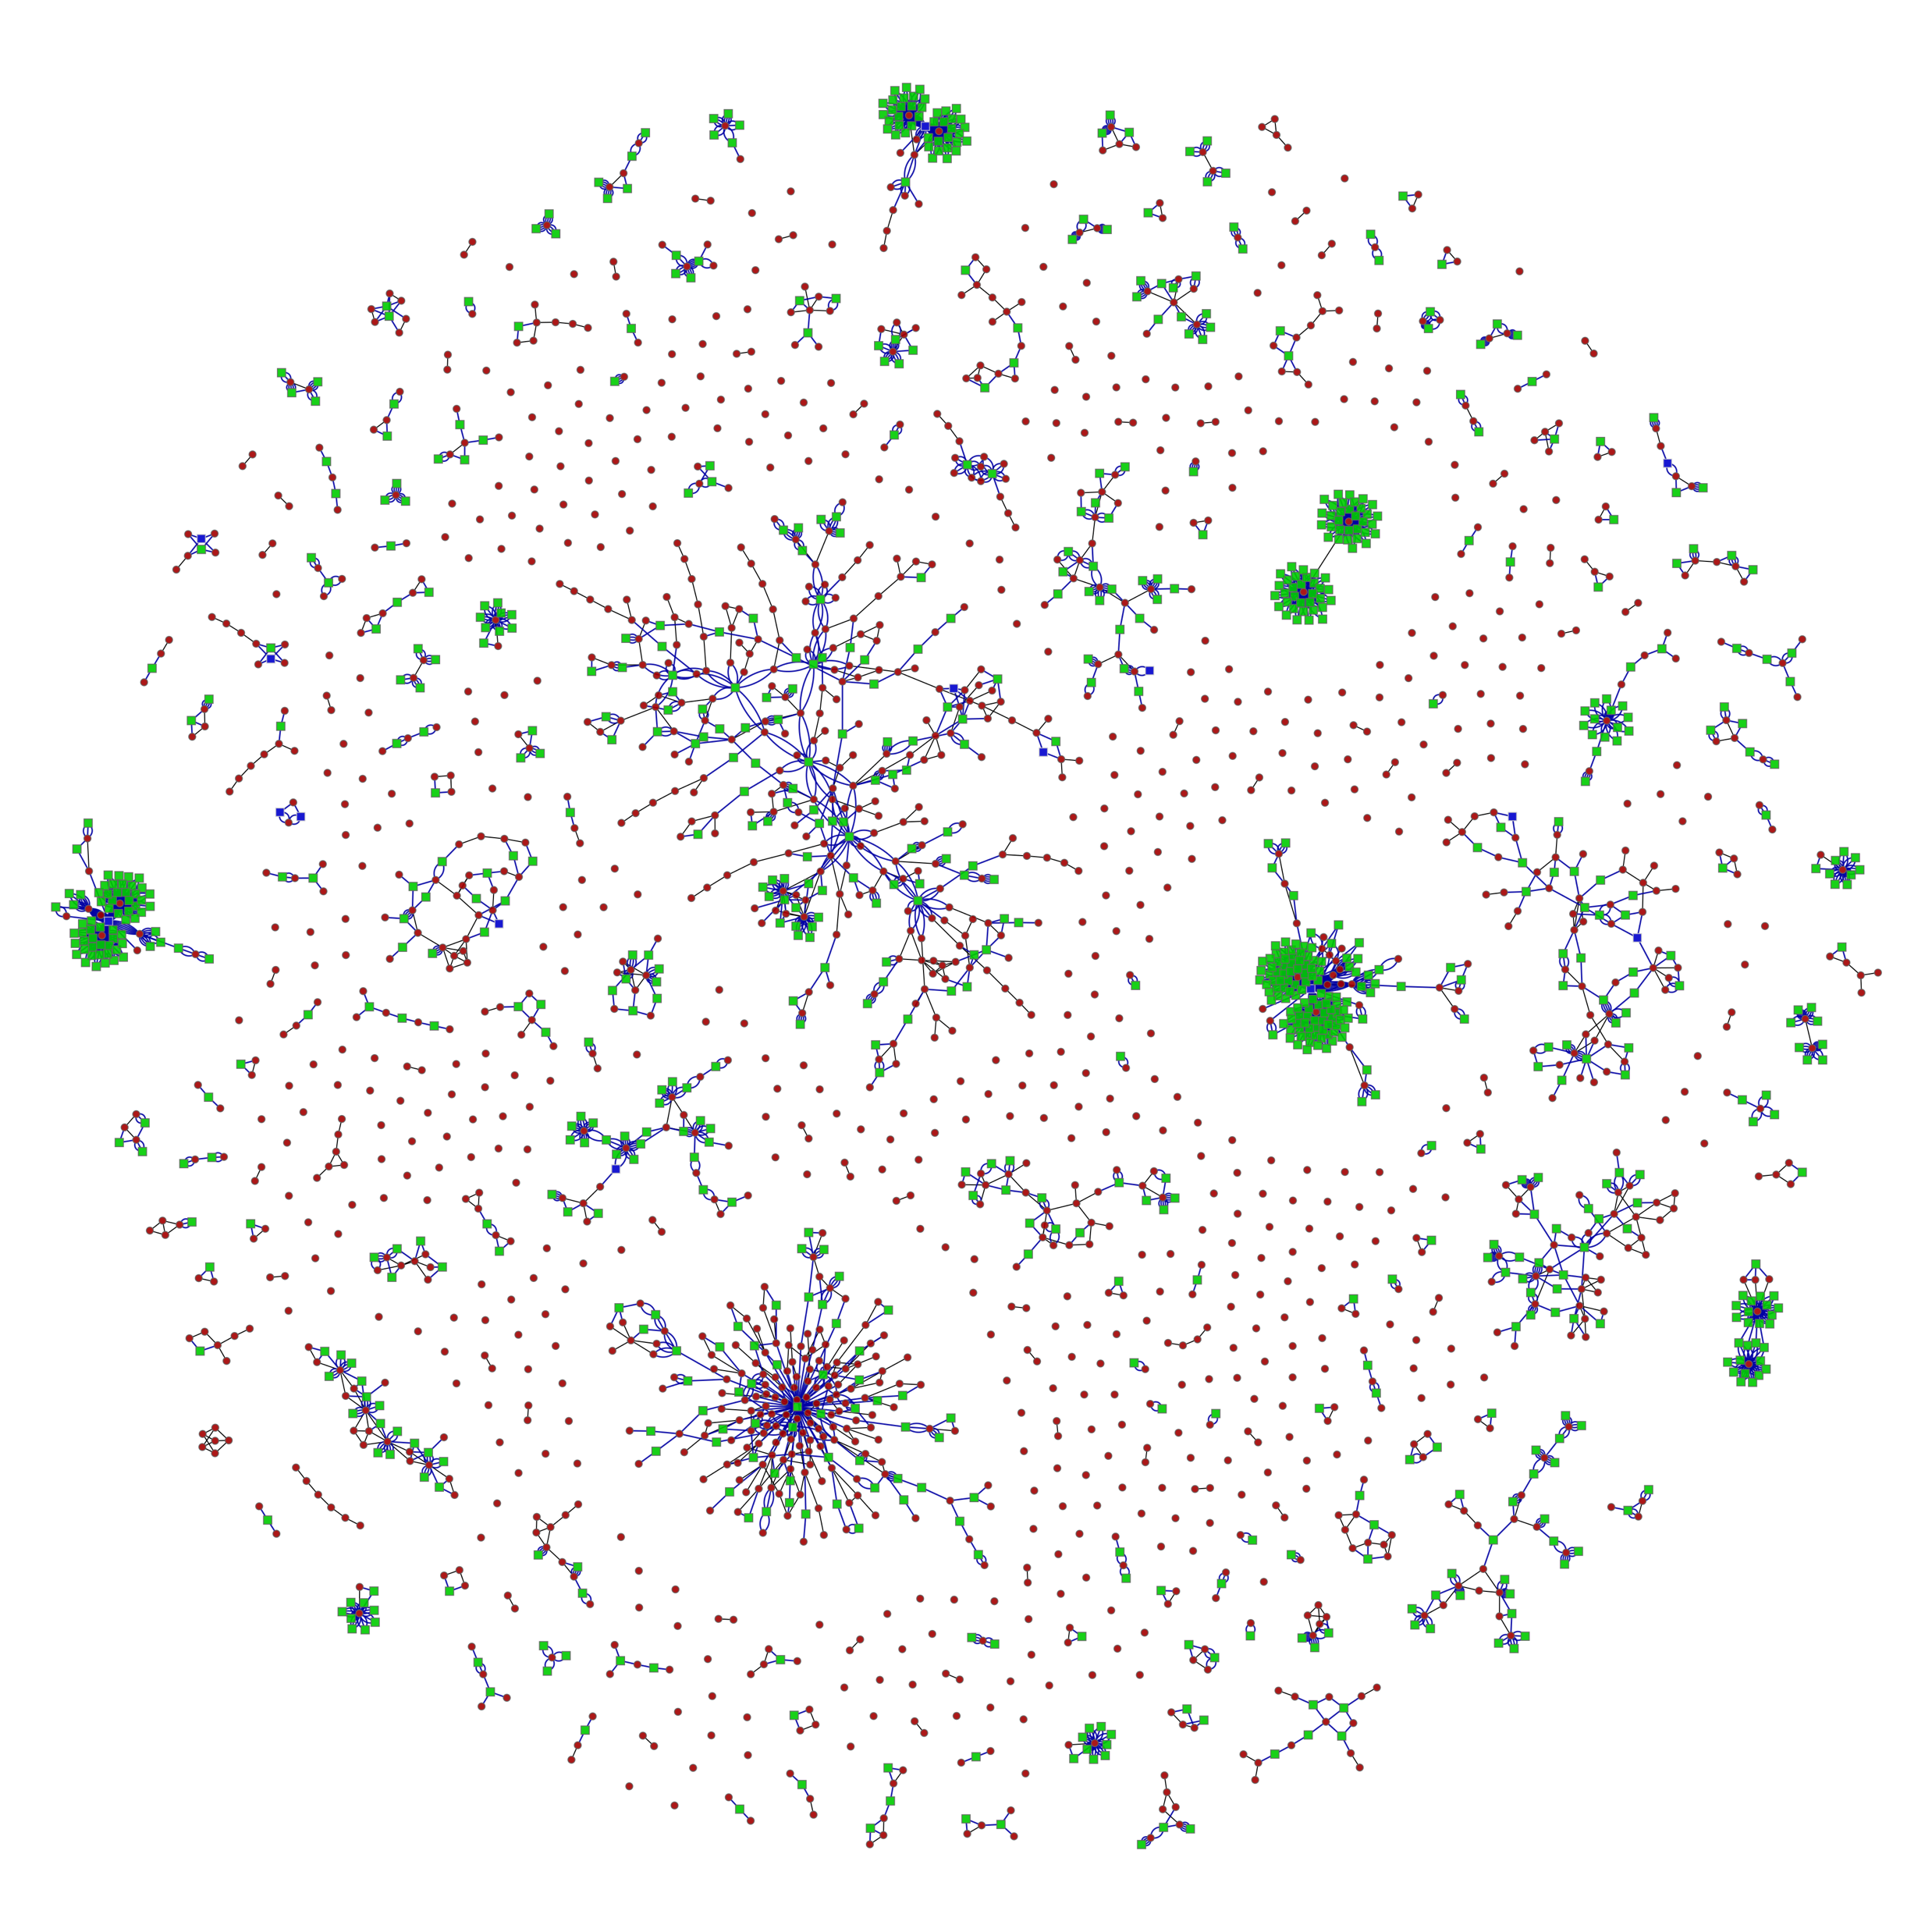
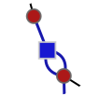
Delta Decomposition
A delta component
= connected hunks
hunk
link by syntax
link by refactoring
link by change
691 components

Slide 13
DDJ: DD on Java Source Code Changes
Compare source code (AST)
Decompose delta
Bisect, select, patch
Build and test
✔︎
Vgood
Vbad
(Diff/TS)
(500+ rules)
(Patch/AST+DD.py)
1
2
3
4

Slide 14
AST Differencing
Prog1
parse
represent
XML
AST1
Tree Differencing
Engine
Prog2
parse
AST delta
(set of tree hunks)
AST2

Slide 15
AST Patching
Prog
parse
unparse
Prog'
AST
Tree Patching Engine
XML
AST'
AST delta
(set of tree hunks)

Slide 16
Evaluation
Two implementations
DDP for plain text changes (original DD) ← baseline
DDJ for Java program changes (proposed)
Three evaluation criteria
Granularity: patch size (# tokens)
Efficiency: build success rate
Cost: tests executed
Two datasets
[Small delta] 194 real bugs from Defects4J [Just et al., 2014]
[Large delta] 8 real regressions from 6 open source Java projects

Slide 17
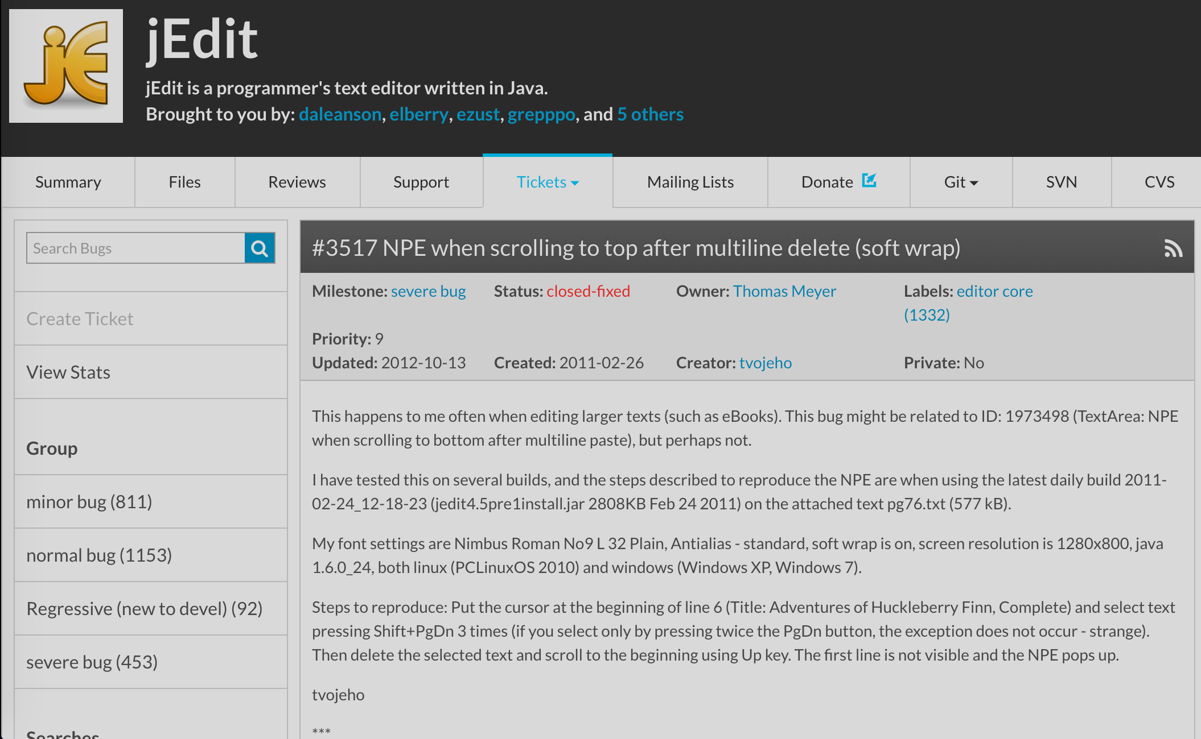
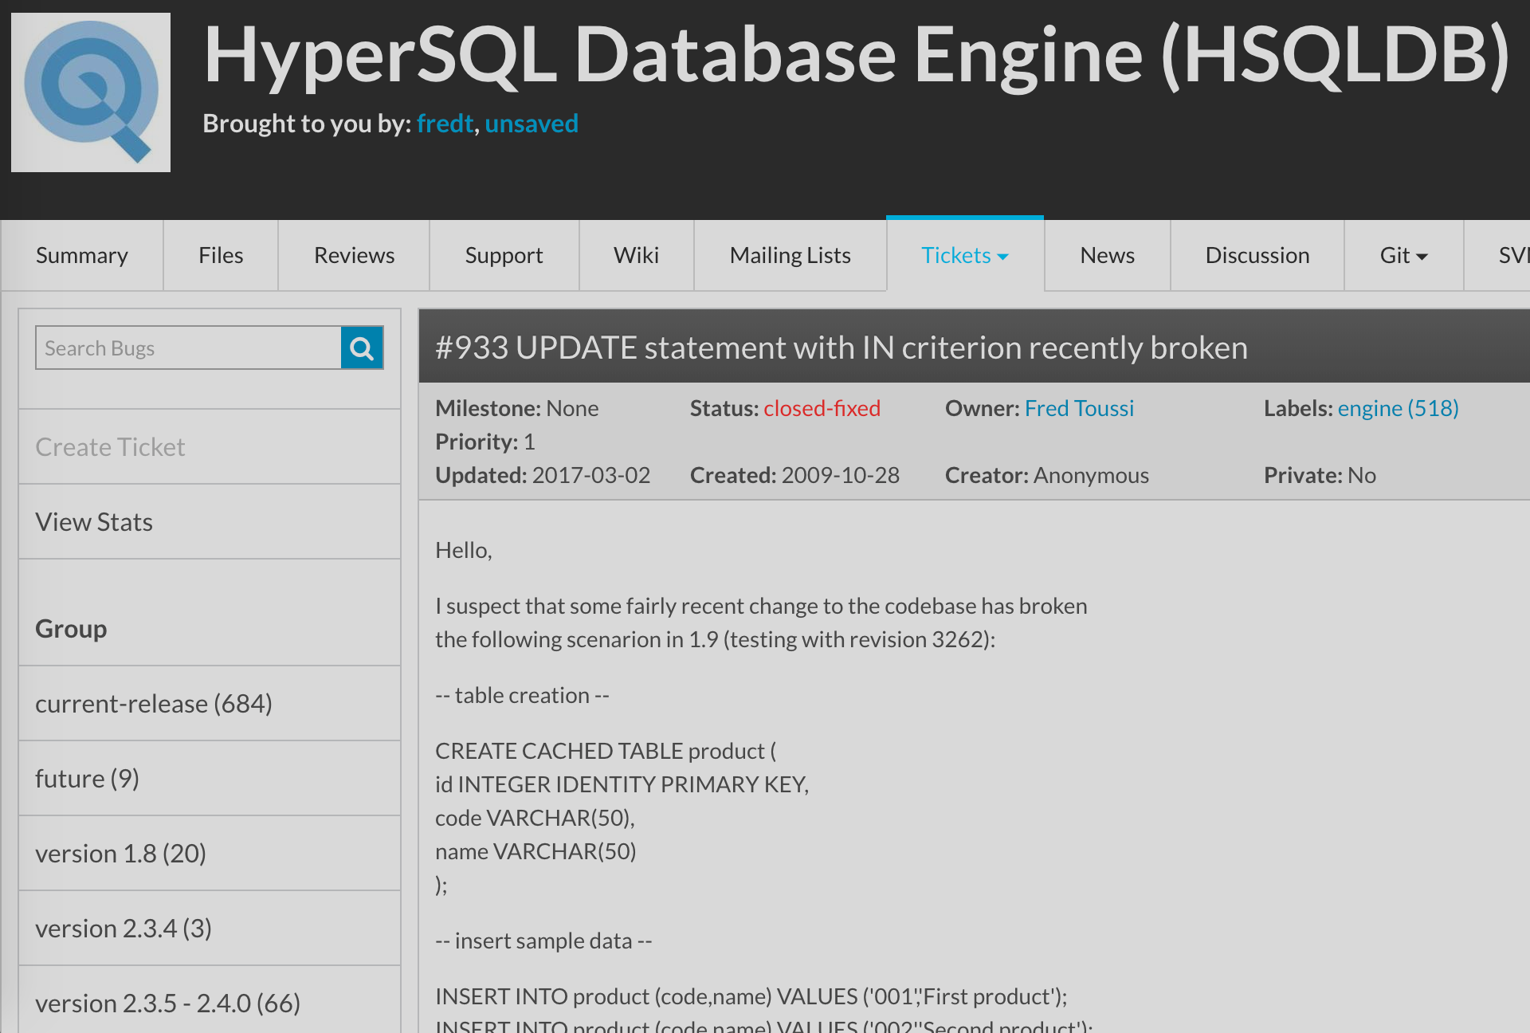
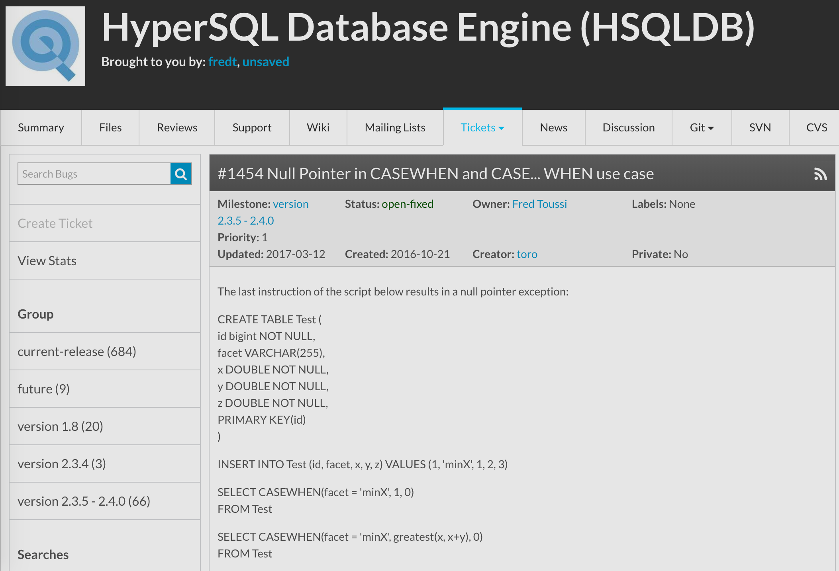
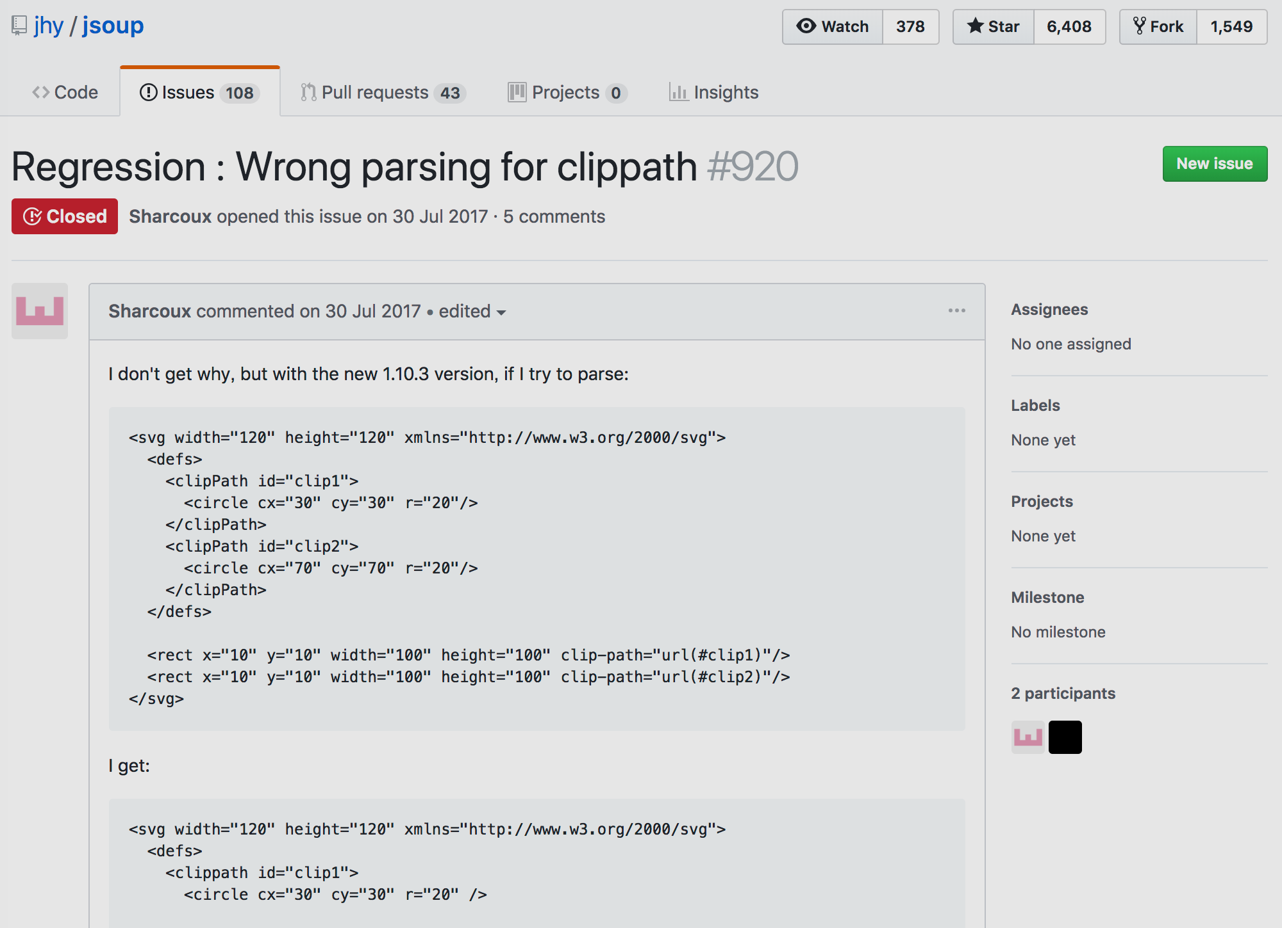
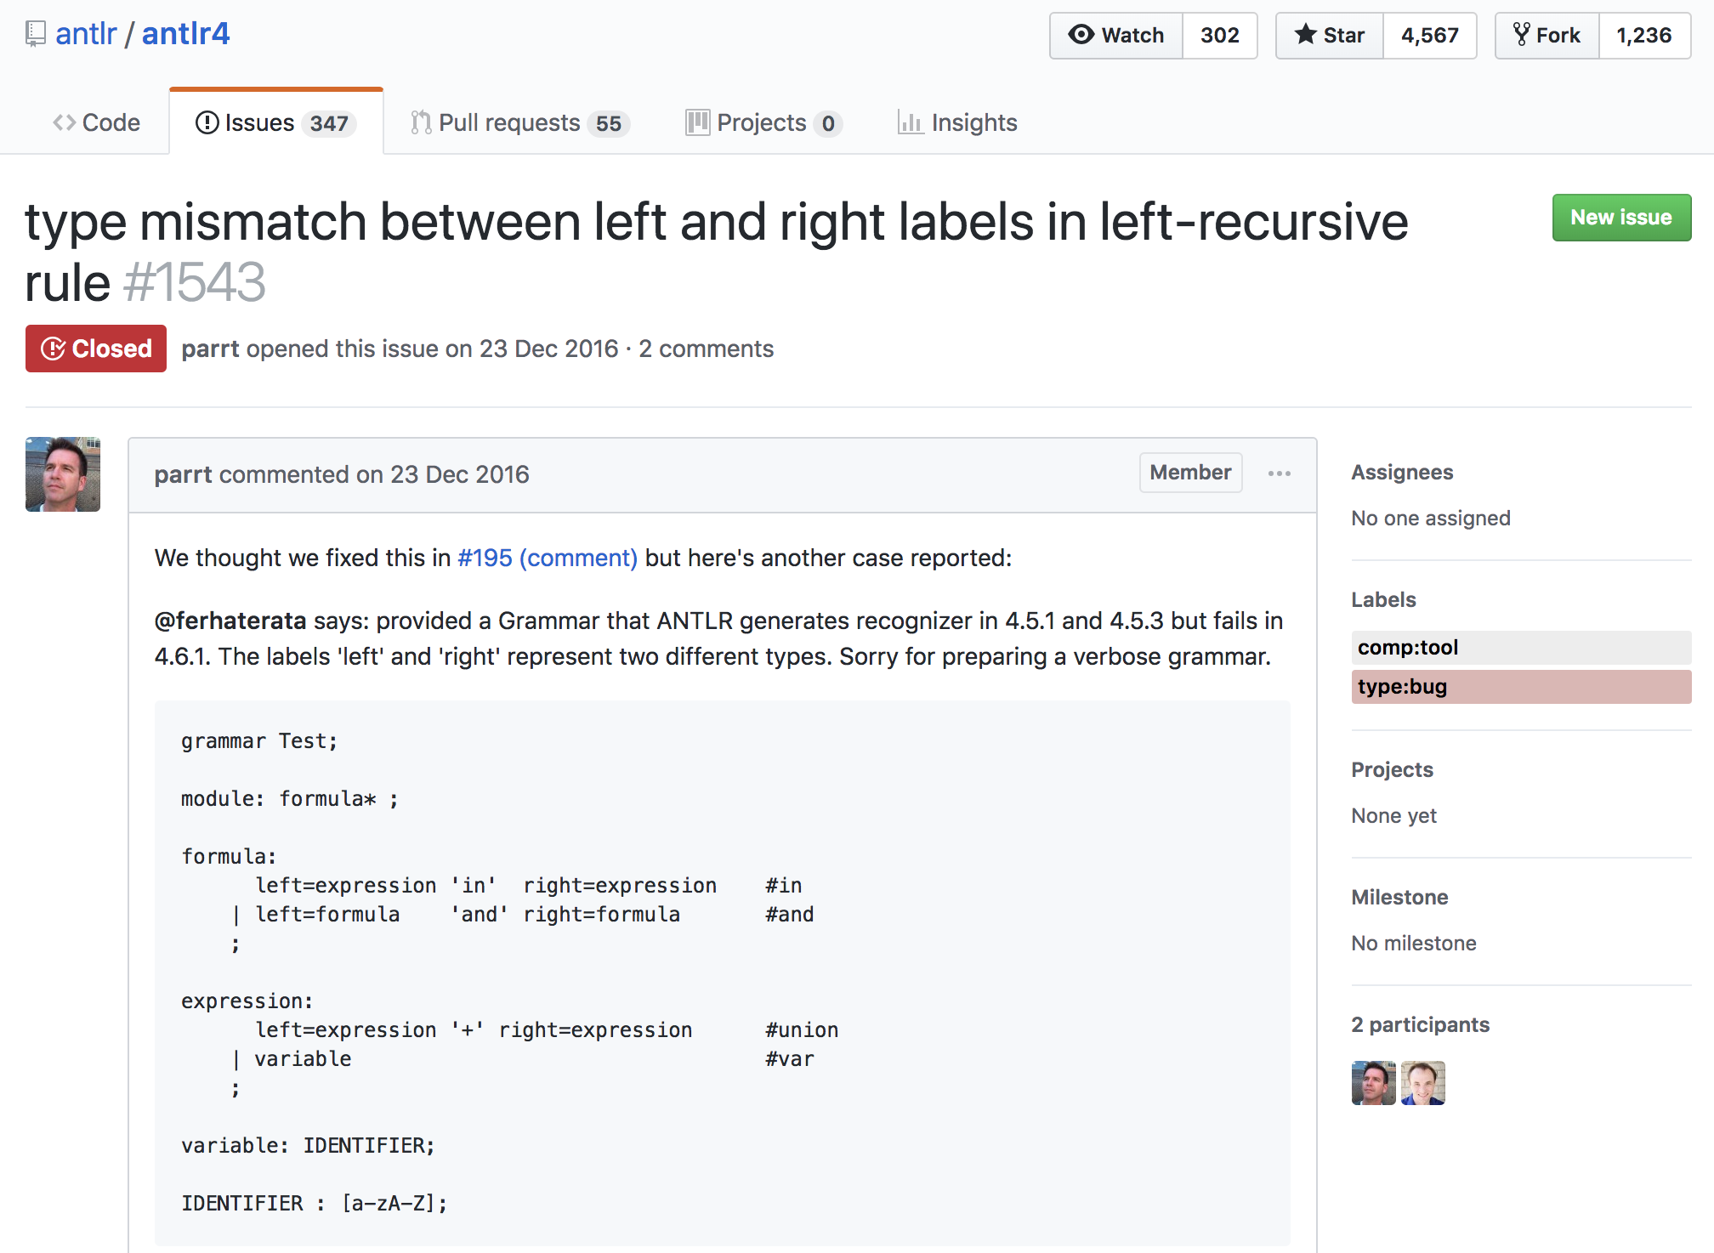
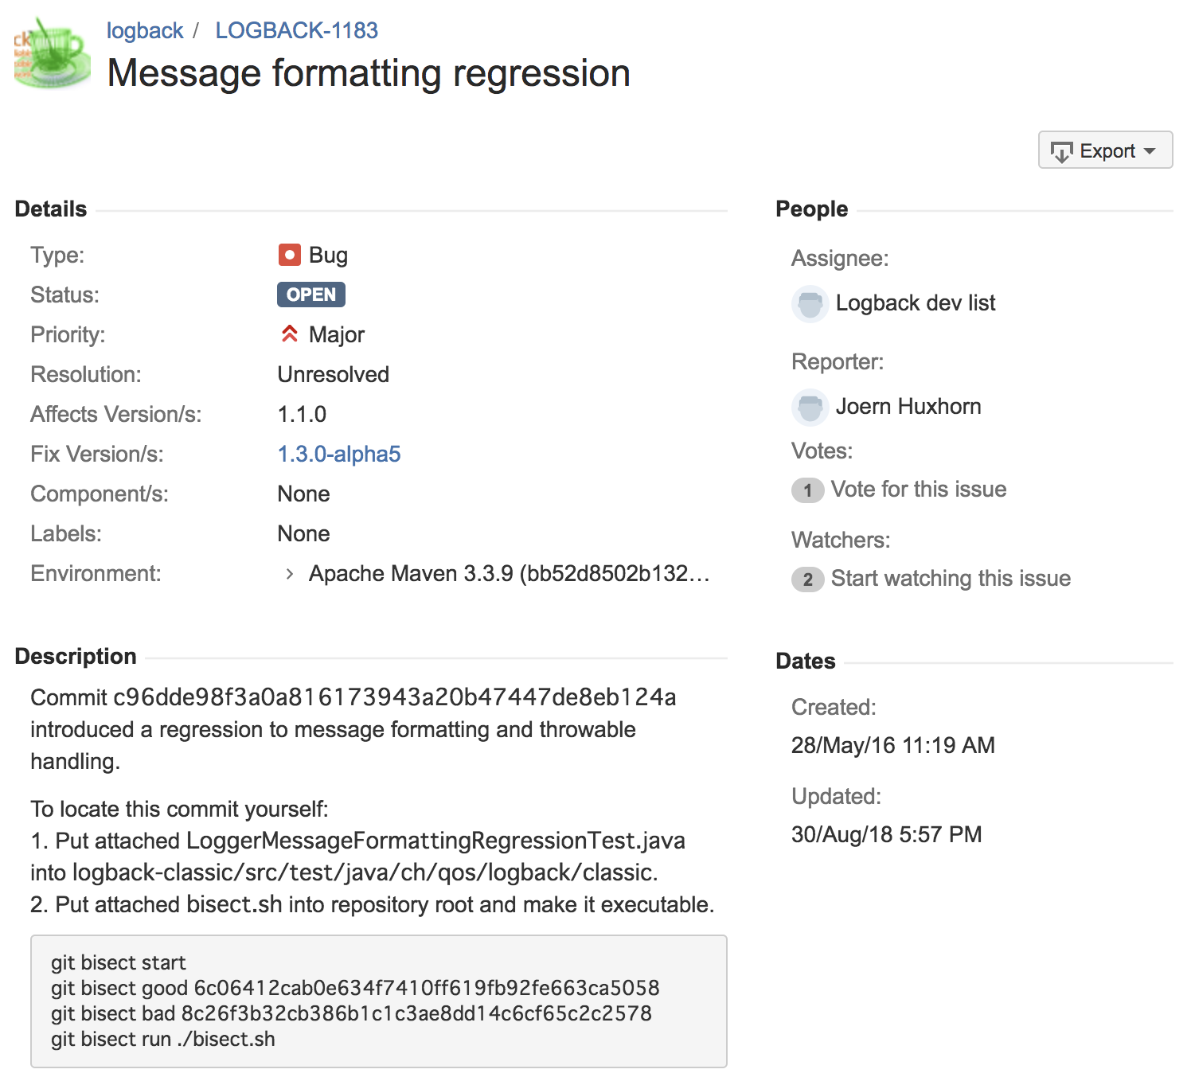
Real Regression Bugs

Slide 18
Deltas between Vgood and Vbad
 | Vgood | Vbad
ANTLR | 14f05bb | aacd2a2
MATH | v2.0 | v2.2
HSQLDB1 | r3227 | r3262
HSQLDB2 | v2.3.2 | v2.3.3
JEDIT | r12114 | r12710
JSOUP1 | b033535 | v1.10.3
JSOUP2 | v1.10.2 | v1.10.3
LOGBACK | v1.0.13 | v1.1.0
Size of delta between Vgood and Vbad (# tokens)

Slide 19
Delta Components and Patch Size
Number of delta components
Patch size (# tokens)

Slide 20
Build Success Rate and Tests Executed
Build success rate
Tests executed

Slide 21
Execution Time (Breakdown)
Execution time
on AWS (16 cores, 8GB RAM/core)
Execution time breakdown

Slide 22
Defects4J Dataset
Collection of real bugs from 6 Java projects [Just et al. 2014]
A bug is stored as (Vbug, Vfix , T)
Vbug: faulty version, Vfix: fixed version
T: test suite that contain at least one failing test that triggers the bug
Changes between Vbug and Vfix contains bug fixes only
Vbug is human-extracted from ∆(Vprev, Vfix)
∆(Vprev, Vfix)
Vprev
Vbug
Vfix
other changes
isolated bug fix

Slide 23
Deltas (in Total) [D4J]
 | Bugs
Chart | 11
Closure | 69
Lang | 22
Math | 53
Mockito | 30
Time | 9
Size of delta (# tokens)

Slide 24
Delta Components and Patch Size [D4J]
Number of delta components
Patch size (# tokens)

Slide 25
Build Success Rate and Tests Executed [D4J]
Build success rate
Tests executed

Slide 26
Execution Time (Breakdown) [D4J]
Execution time
on AWS (16 cores, 8GB RAM/core)
Execution time breakdown

Slide 27
Summary
Goal
Fixing real regressions in an automated and efficient way
Approach
Improving delta debugging on source code changes
by avoiding UNRESOLVED test results
Contribution
Syntax- and semantics-aware decomposition of delta
by AST differencing/patching and 500+ coupling rules
Result
Dataset-L: 73% smaller patch, 40% more test exec, 0.2-5.6x time (DD-bound)
Dataset-S: 50% smaller patch, 5% more test exec, 1-6.8x time (decomp-bound)

Slide 28
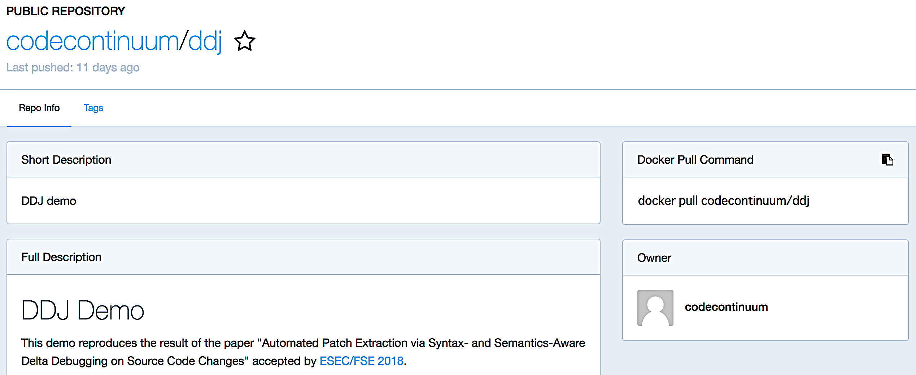
https://hub.docker.com/r/codecontinuum/ddj/

